Slide 1
INTRUSION DETECTION SYSTEM
By Team 4

Slide 2
Team Members
Anupam Misra
Saptarshi Manna
Aditya Gupta
Aditya Mohan Gupta
Akash Kumar
Deeksha Sahu
Kritika Singh
Teaching Assistant
Yahnit Sirineni

Slide 3
Problem Statement

Slide 4
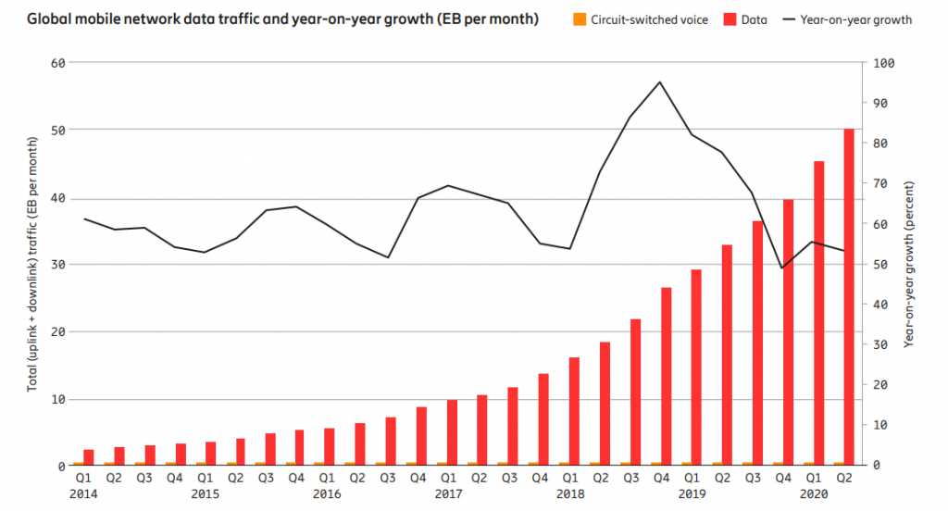
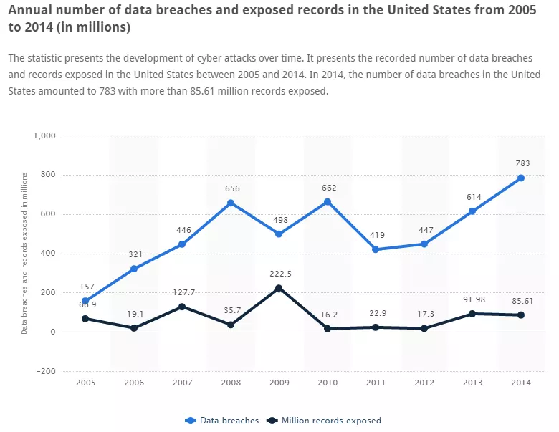
Rapid growth in network traffic
Increase in data breach
Sensitive data is exposed
Abundance of network packet information
Increased computing power
Advancement in machine learning
Goal
Distinguishing benign network traffic from malicious network-based attacks
Leverage machine learning techniques

Slide 5
Introduction to IDS

Slide 6
A set of techniques used for detection of abnormal behaviours on network
Based on the assumption that behaviour of intruder is different from a normal user
IDS is capable of detecting malicious activities that cannot be detected by conventional firewalls
It is a passive alert system. It detects attacks but does not prevent it.
IDS categories
Signature based IDS
Anomaly based IDS
Dataset used KDD99 and CIC-IDS 2017

Slide 7
Signature based Intrusion Detection System
Presents the attack in the form of signatures and patterns
Patterns are then maintained as a database of known attack scenarios and signatures
Signatures are then compared with the data received on the network
Advantages
Produces very low false positives
Easy to develop
Requires less computational resources
Disadvantages
Detects only those threats that are in its database
Updating of new attacks is a time consuming process

Slide 8
Anomaly based Intrusion Detection System
Based on the statistical analysis
Detects attacks based on irregularities in the pattern with respect to normal pattern
Creates a model of the normal behaviour system
Look for activities that differ from the normal behaviour
Advantages
Capable of detecting new unknown threats
Disadvantages
Training time may be long
Increased problem of false positive alerts

Slide 9
Data and Features

Slide 10
Types of Attacks
Probing - An attacker scans a network or host to gather known vulnerabilities and information about the host computer. Probe attack abuses the computer’s legitimate features, social engineering techniques.
Denial of Service - An attacker prevents the legitimate users from using services on the network, by overwhelming or flooding the system with request and consuming the resources by exploiting system’s misconfigurations. DoS attacks can be classified on the basis of the services that an attacker exploits. Neptune is a popular DoS attack.
U2R - An attacker first hacks into a normal/legitimate user’s account on the network and then exploits the vulnerabilities so that he can gain root access of the system. Regular buffer overflows is the most usual exploit in this attack class.

Slide 11
Types of Attacks
R2L - It is a class of attacks where an attacker sends packets to a machine on the network, then exploits its vulnerabilities and illegally gains local access as a user.
Distributed DoS - An attack carried out by HOIC, an open source network stress testing and denial-of-service attack application written in BASIC designed to attack as many as 256 URLs at the same time.
Infiltration of the network from inside - A vulnerable application is exploited. The victim receives a malicious document through the email. Then, after successful exploitation using Metasploit framework, a backdoor will be executed on the victim’s computer. Now different attacks are conducted on the victim’s network include IP sweep, full port scan and service enumerations using Nmap.

Slide 12
Summary of dataset
KDD 99
41 features
Basic features of individual tcp connection (9)
Content features within a connection by domain knowledge(13)
Traffic features computed using a two seconds time window(19)
1 attack type to be determined
Total number of data in training set - 48,98,431
Total number of data in test set - 3,11,029

Slide 13
Summary of dataset
CIC-IDS 2017
88 features
CICFlowMeter is used to generate traffic
Tool generates both forward and backward traffic
Traffic is categorized in Benign and Malign profile
Machine learning models are used to generate traffic
1 attack type to be determined(8 different types are present in dataset)
Total number of data in training set - Huge(in the scale of billions)

Slide 14
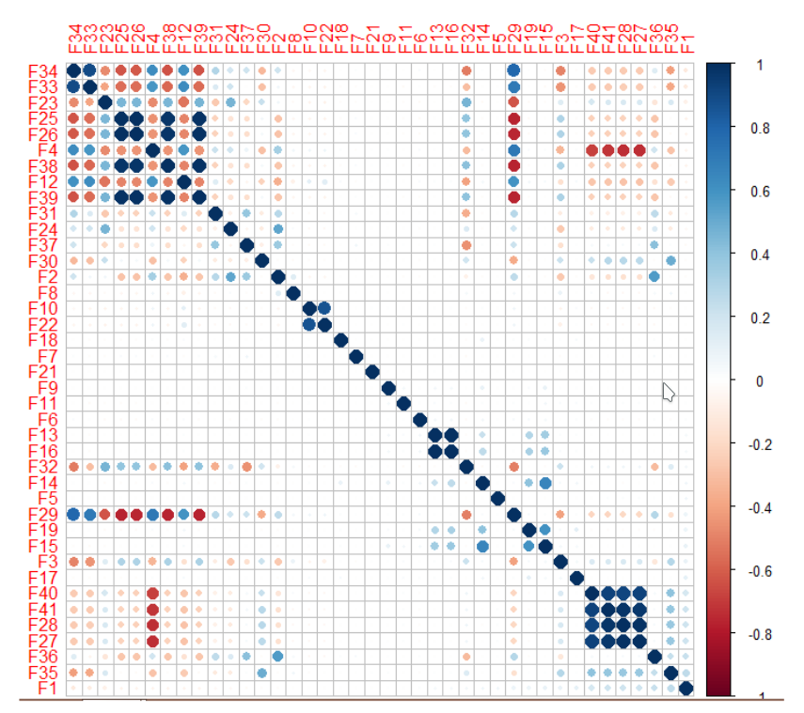
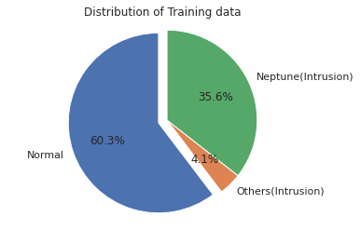
Exploratory Data Analysis
HHHHdsddddss
High Volume of Data
Duplication (almost 40%)
Highly correlated features

Slide 15
Feature Extraction
Correlation Model
Pearson correlation
Signifies the interdependence of two or more random variables
Highly dependent features do not carry value on their own
Random Forest Technique
Feature significance detection
Top 30 features are selected according to their significance weight and the feature ranks
Principal Component Analysis was performed for dimensionality reduction

Slide 16
Models And Results

Slide 17
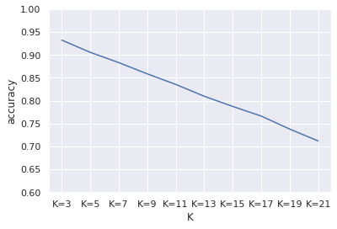
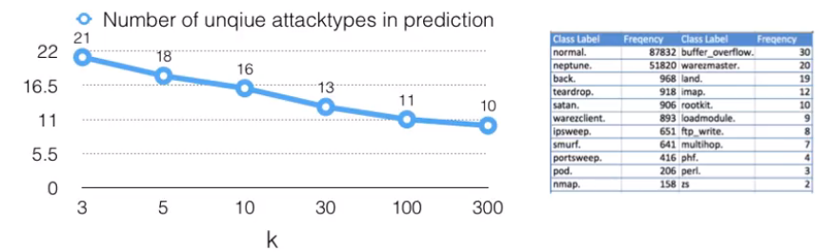
kNN
Accuracy is dropping as K is increasing
Not an uniform distribution
Skewed distribution
Attack type with fewer samples are labelled incorrectly

Slide 18
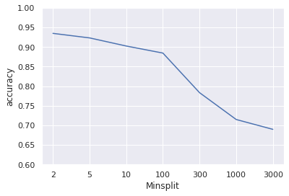
Decision Tree
Splits are on the nodes
# of connections to the same service
Wrong fragment
# of connections to different hosts
Source Bytes
Accuracy is dropping with increasing Minsplits
Model gives good insights on which feature is important

Slide 19
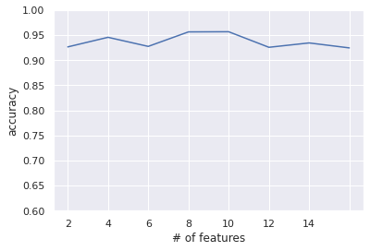
Random Forest
Ensemble method
Prevents overfitting
Good accuracy
Optimal number of features 10

Slide 20
Logistic Regression, Multiclass SVM, Neural Networks
Logistic regression accuracy - .8232
Multiclass SVM accuracy - .8863
Neural Network
Accuracy with 4 layers - .9438
Accuracy with 8 layers - .9754
For Logistic regression and Multiclass SVM, Normal and Intrusion types are classified using Logistic regression at first.

Slide 21
Analysis

Slide 22
DoS attacks
Short duration (large number of connections in short duration)
Backtrack - large number of src and dest bytes
Teardrop and Pod - sent large # of wrong segments
Neptune and Smurf - sent large # of requests in very short time
Land - connection from the same host

Slide 23
Probe attacks
Very low login successful rate
Portsweep - longest duration and large src bytes
IPsweep - high % of connections to different hosts
Satan- high % of connections to different services
Land - connection from the same host

Slide 24
R2L attacks
guess_password - high number of failed logins
multihop - high # of file creation
ftp_write - high # of urgent packets
phf - high # of operations on access control files

Slide 25
U2R attacks
High number of root accesses
buffer_overflow - high number of compromised connections
Load module - high % of connections to different services
perl - high # of files creation and high # of shell prompts

Slide 26
Future Direction

Slide 27
Result of Random forest and Decision tree can be interpreted
Snort is a packet sniffing and intrusion detection tool
We can get the top k features from Random forest and Decision tree
Then we can write custom rules and place it in Snort’s configuration file
Due to limited resources this is not implemented
Results can be replicated in a lab environment

Slide 28
Thank You

